Slide 1

Heredity and Evolution
Evolution By Stages

Slide 2


It is all very well to say that very dissimilar- looking structures evolve from a common ancestral design.

Slide 3
But those are guesses
about what happened in history.

Slide 4

Are there any
current examples of such a process?
Wild cabbage plant is one such example

Slide 5
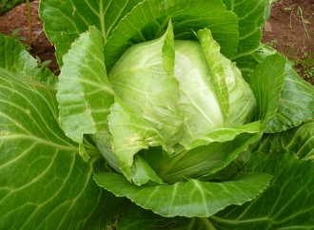
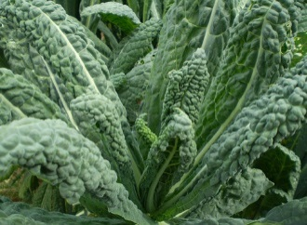
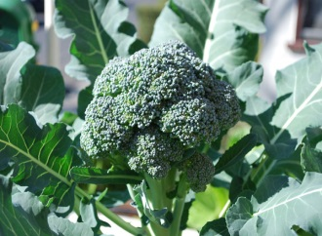
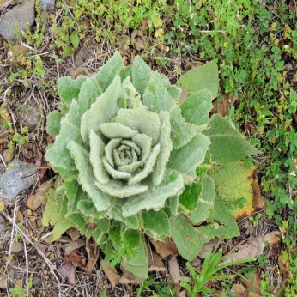
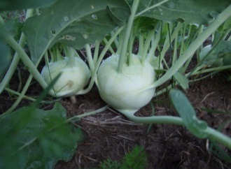
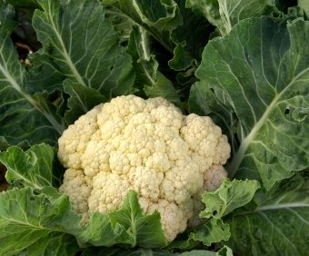
Evolution by stages of Cabbage
Humans, from more than two thousand years, cultivated wild cabbage as a food plant, and generated different vegetables from it by selection.
The wild cabbage plant is selected and different cabbages were grown for different purposes.
Some farmers have wanted to select for very short distances between leaves, and have bred the cabbage we eat.
Cabbage
Kale
Some have simply looked for slightly larger leaves, and come up with a leafy vegetable called kale.
Broccoli
Some have bred for swollen parts and come up with kohlrabi.
Some have wanted to select for arrested flower development, and have bred broccoli.
Some have bred for sterile flowers and made the cauliflower
Wild cabbage
Kohlrabi
Cauliflower

Slide 6
Evolution by stages of Cabbage
So, we can say that all these structures are descended from the same ancestor.
Cabbage
Kale
Broccoli
Wild cabbage
Kohlrabi
Cauliflower

Slide 7

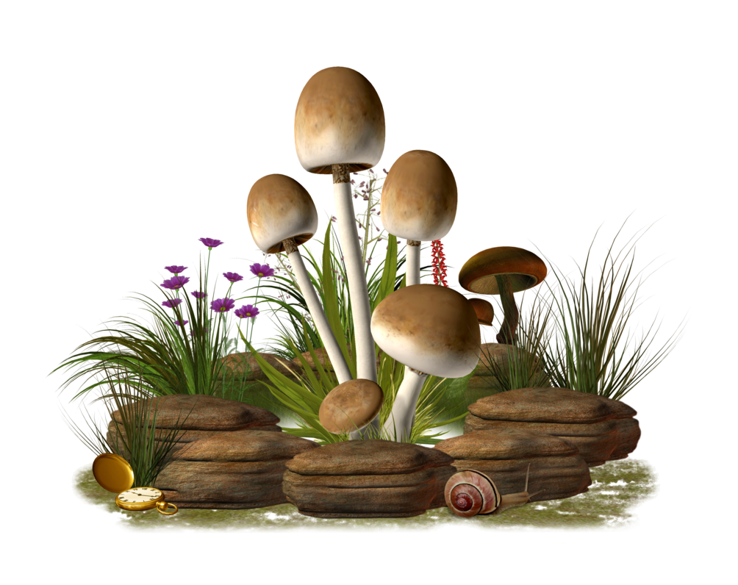

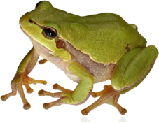
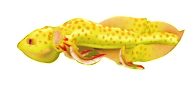
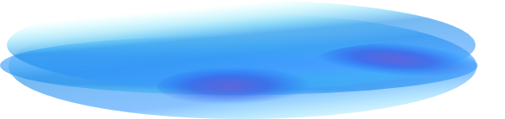

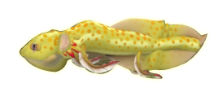
Evolution and its progress
But due to change in environment some fishes started evolving to form a intermediate structure like lung fish
Lung fish further evolved into another successful adaption which is the frog.
But lung fish is not a successful adaption so lung fish again started evolving.
Pisces is a successful aquatic adaption, so we can see so many fishes living in the sea.

Slide 8
Evolution and its progress
But it is just that natural selection and genetic drift have together led to the formation of a population that cannot reproduce with the original one.
But does that mean the old species will disappear.
No, the old species will not disappear
The newly generated species are in any way not ‘better’ than the older one.
A new species has emerged.

Slide 9
Thank You

